Slide 1
Quick React Guide

Slide 2
Node Installation
Install node js
For Windows
Download via https://nodejs.org/en/download/
Or using package manager https://chocolatey.org/install
After installed Chocolately, open Admin’s Power Shell and run
choco install nodejs -y
For Mac or UNIX based
Download via https://nodejs.org/en/download/
Or using package manager https://brew.sh/
After installed Homebrew, open Terminal and run
brew install node
Test run,
Open terminal or power shell, then type node –v and npm -v

Slide 3
Initializing a React App
With Create-react-app, run
npm init react-app {react-app-name}
Or
npx create-react-app {react_app_name}
With GatsbyJS
Install gatsby js, run npm i –g gatsby-cli
Then run gatsby new {app_name}
With NextJS
Create new folder with App’s name
Go through new folder and run npm init
Then npm install react react-dom next

Slide 4
Useful additional package
React-router-dom (navigator)
Redux (app state manager)
React-redux (app state manager for React)
Redux-thunk (redux middleware)
CSS framework package eg. React-boostrap, fontawesome, materialize, etc.

Slide 5
Run and Build React App
To run in development mode
Run, npm start or npm run dev
To build the app for deployment
Run, npm build
Then copy folder named “dist” to web server
To test run in production (optional)
Use Serve to test in production environment
Use Now.sh to test in production environment
Use Heroku to test or deploy in production environment

Slide 6
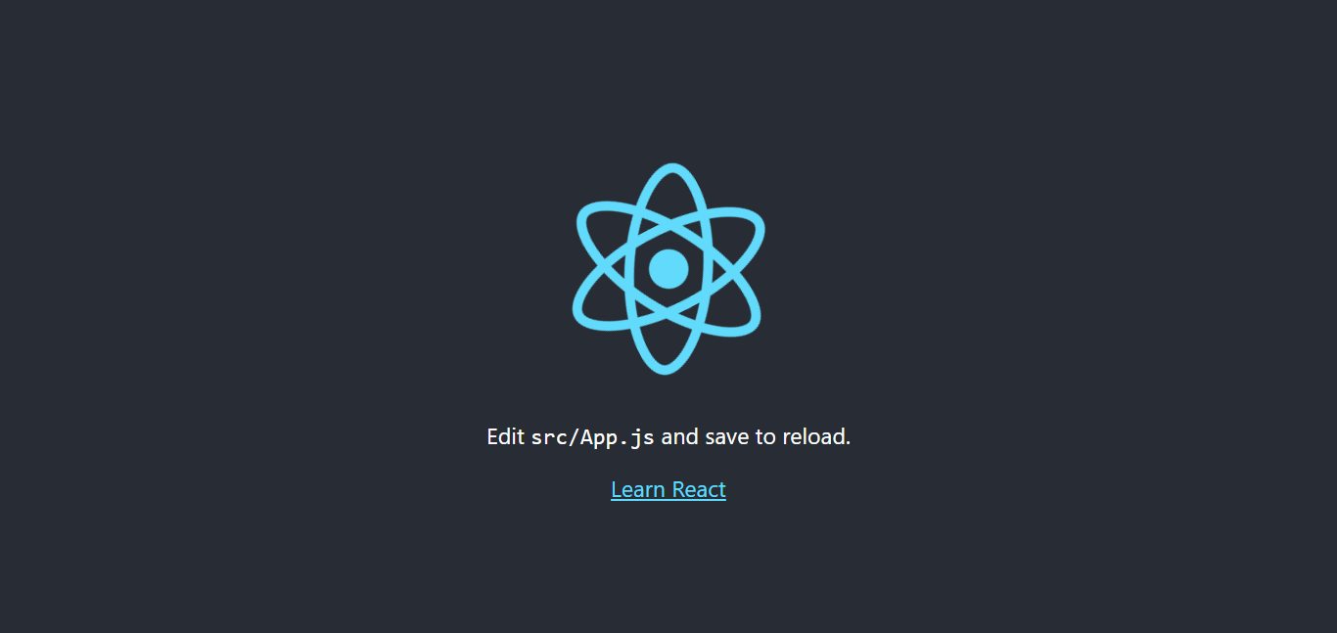
React first glance
After running ‘num run dev’ or ‘npm start’, open browser and access ‘localhost:3000’

Slide 7
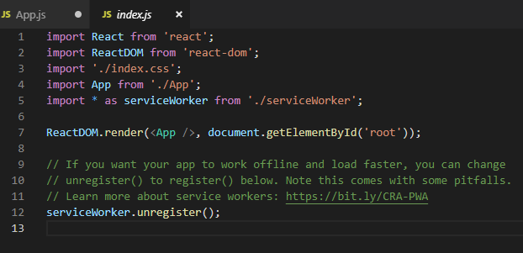
Go through React
index.js
Everything starts here
Import css files from css framework or packages here
Config and apply redux store here
Config and apply react router here
Register serviceWorker here
Etc. !!!

Slide 8
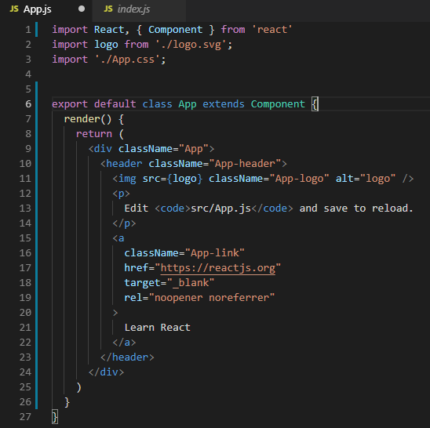
Go through React
App.js
Container component

Slide 9
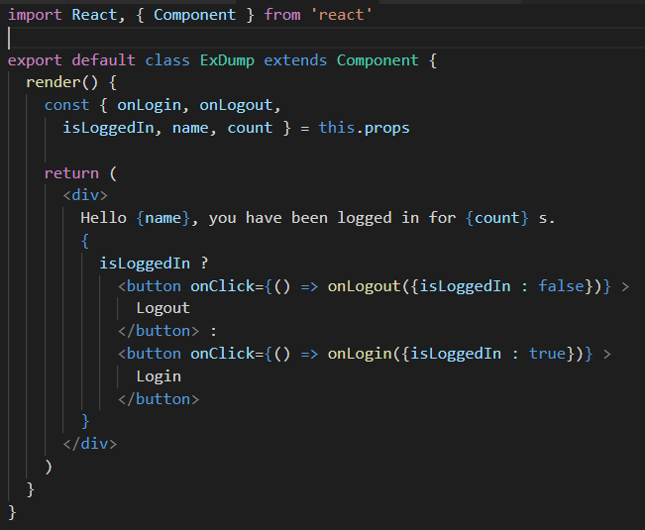
Define a Component

Slide 10
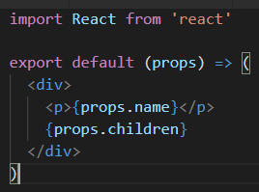
Define a Component (Short-handed)

Slide 11
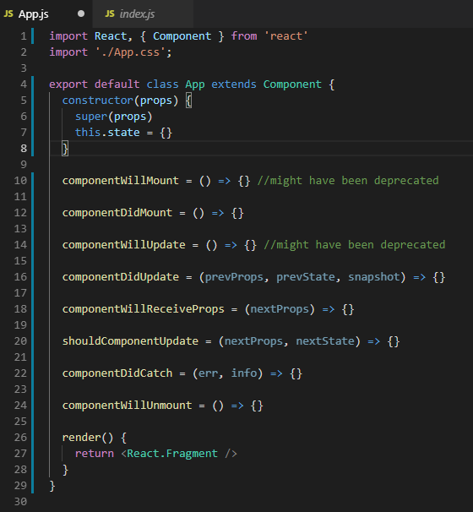
React component’s life cycle

Slide 12
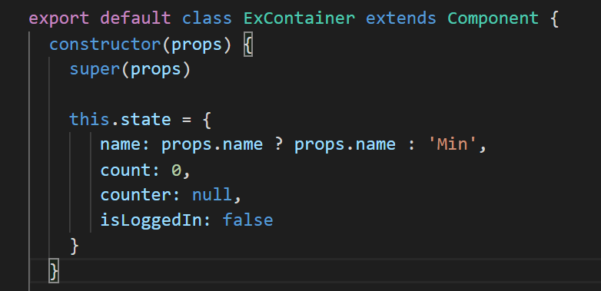
Define variables for component
Default variables for components are known as “State”

Slide 13
Define variables for component
Variables from Parent components are known as “Props”

Slide 14
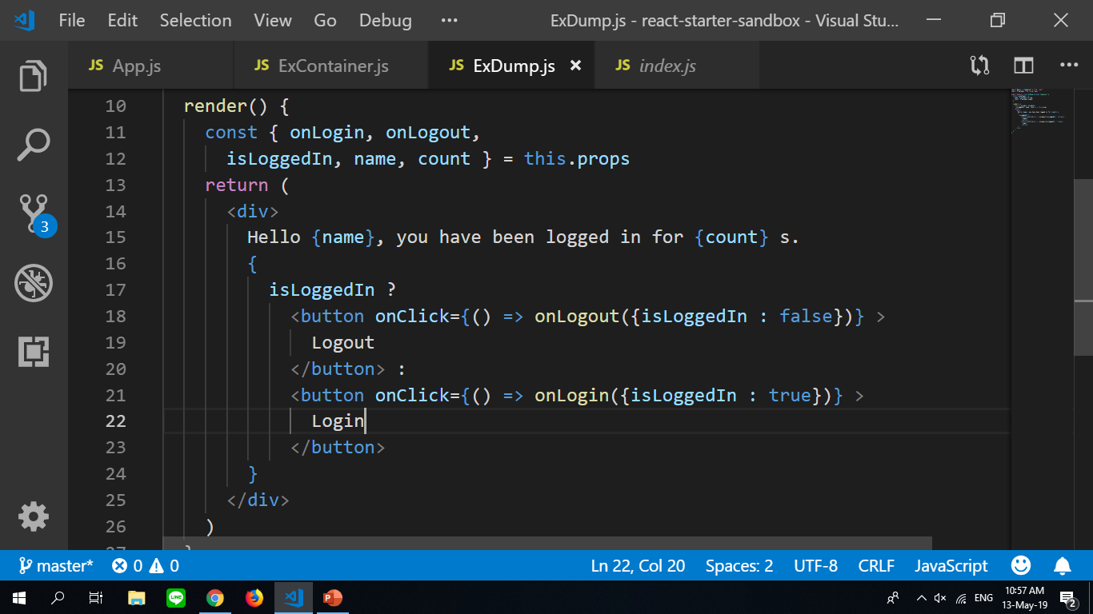
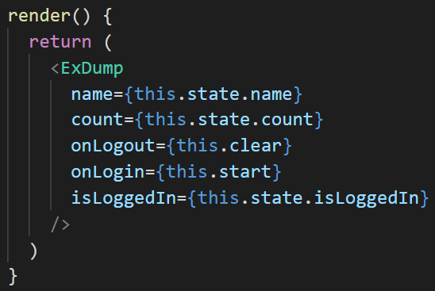
Rendering state and props values
Props State

Slide 15
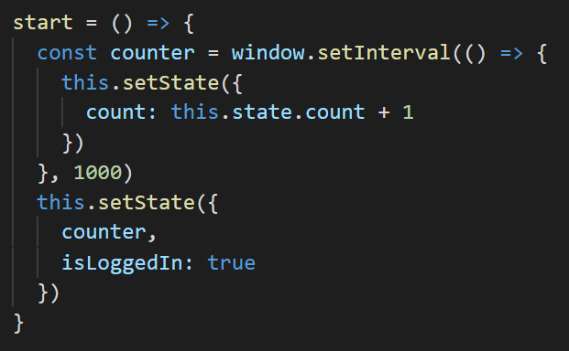
Set state function
To update state, call “this.setState” to set variables
Note
After setState is called the Component will update and rerender

Slide 16
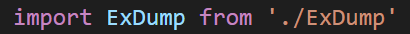
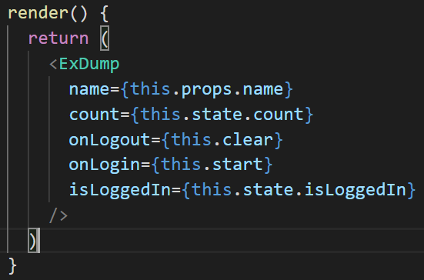
Rendering child components
Import target component
Then call it as Html tag in render()

Slide 17
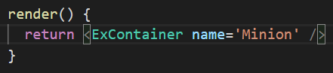
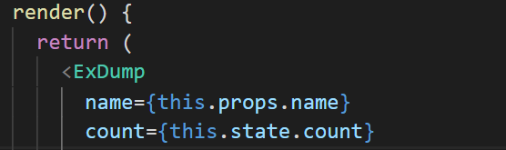
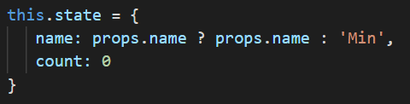
Sending vars from Parent components to Child components
By sending props to child component
Then child components access prop values using “this.props.name”
Component
Prop(s)

Slide 18
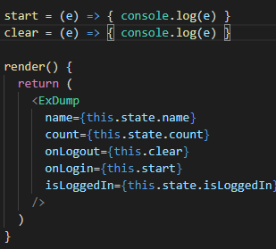
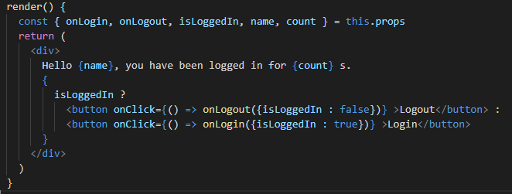
Sending vars and handle events from Child components to Parents
From Parent to Child From Child to Parent
Calls function sent from parents
And sends any value as argument
Send props as function

Slide 19
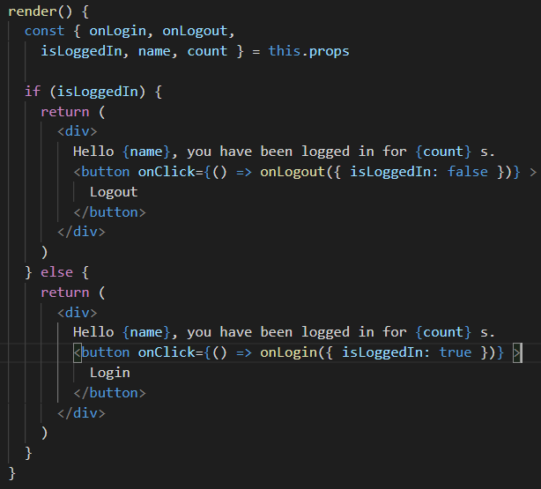
Conditional Rendering
Using If statement in render function to render whole component

Slide 20
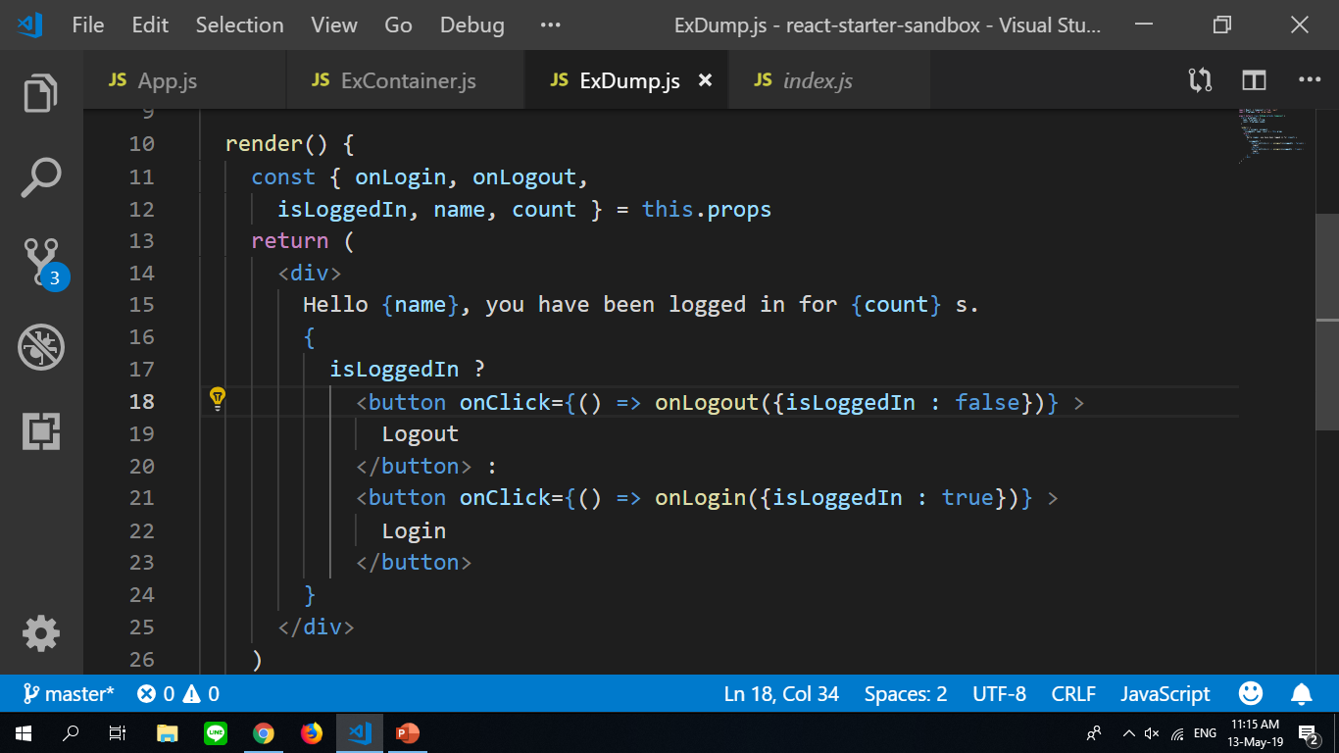
Conditional rendering
Using short-hand if statement for rendering components part
JS short-hand if syntax
{ if this = true ? Do true : Do false }

Slide 21
Github Repro
https://github.com/banned99/gj-react-training/tree/master/src

